Slide 1

Misinformation effect
Analyze the misinformation around the Russia Ukraine Crisis
The amount of misinformation perpetuated by bots
The effect
Mode of escalation
Interaction with Human users
What is misinformation?
Humans can also perpetuate misinformation online.

Slide 2
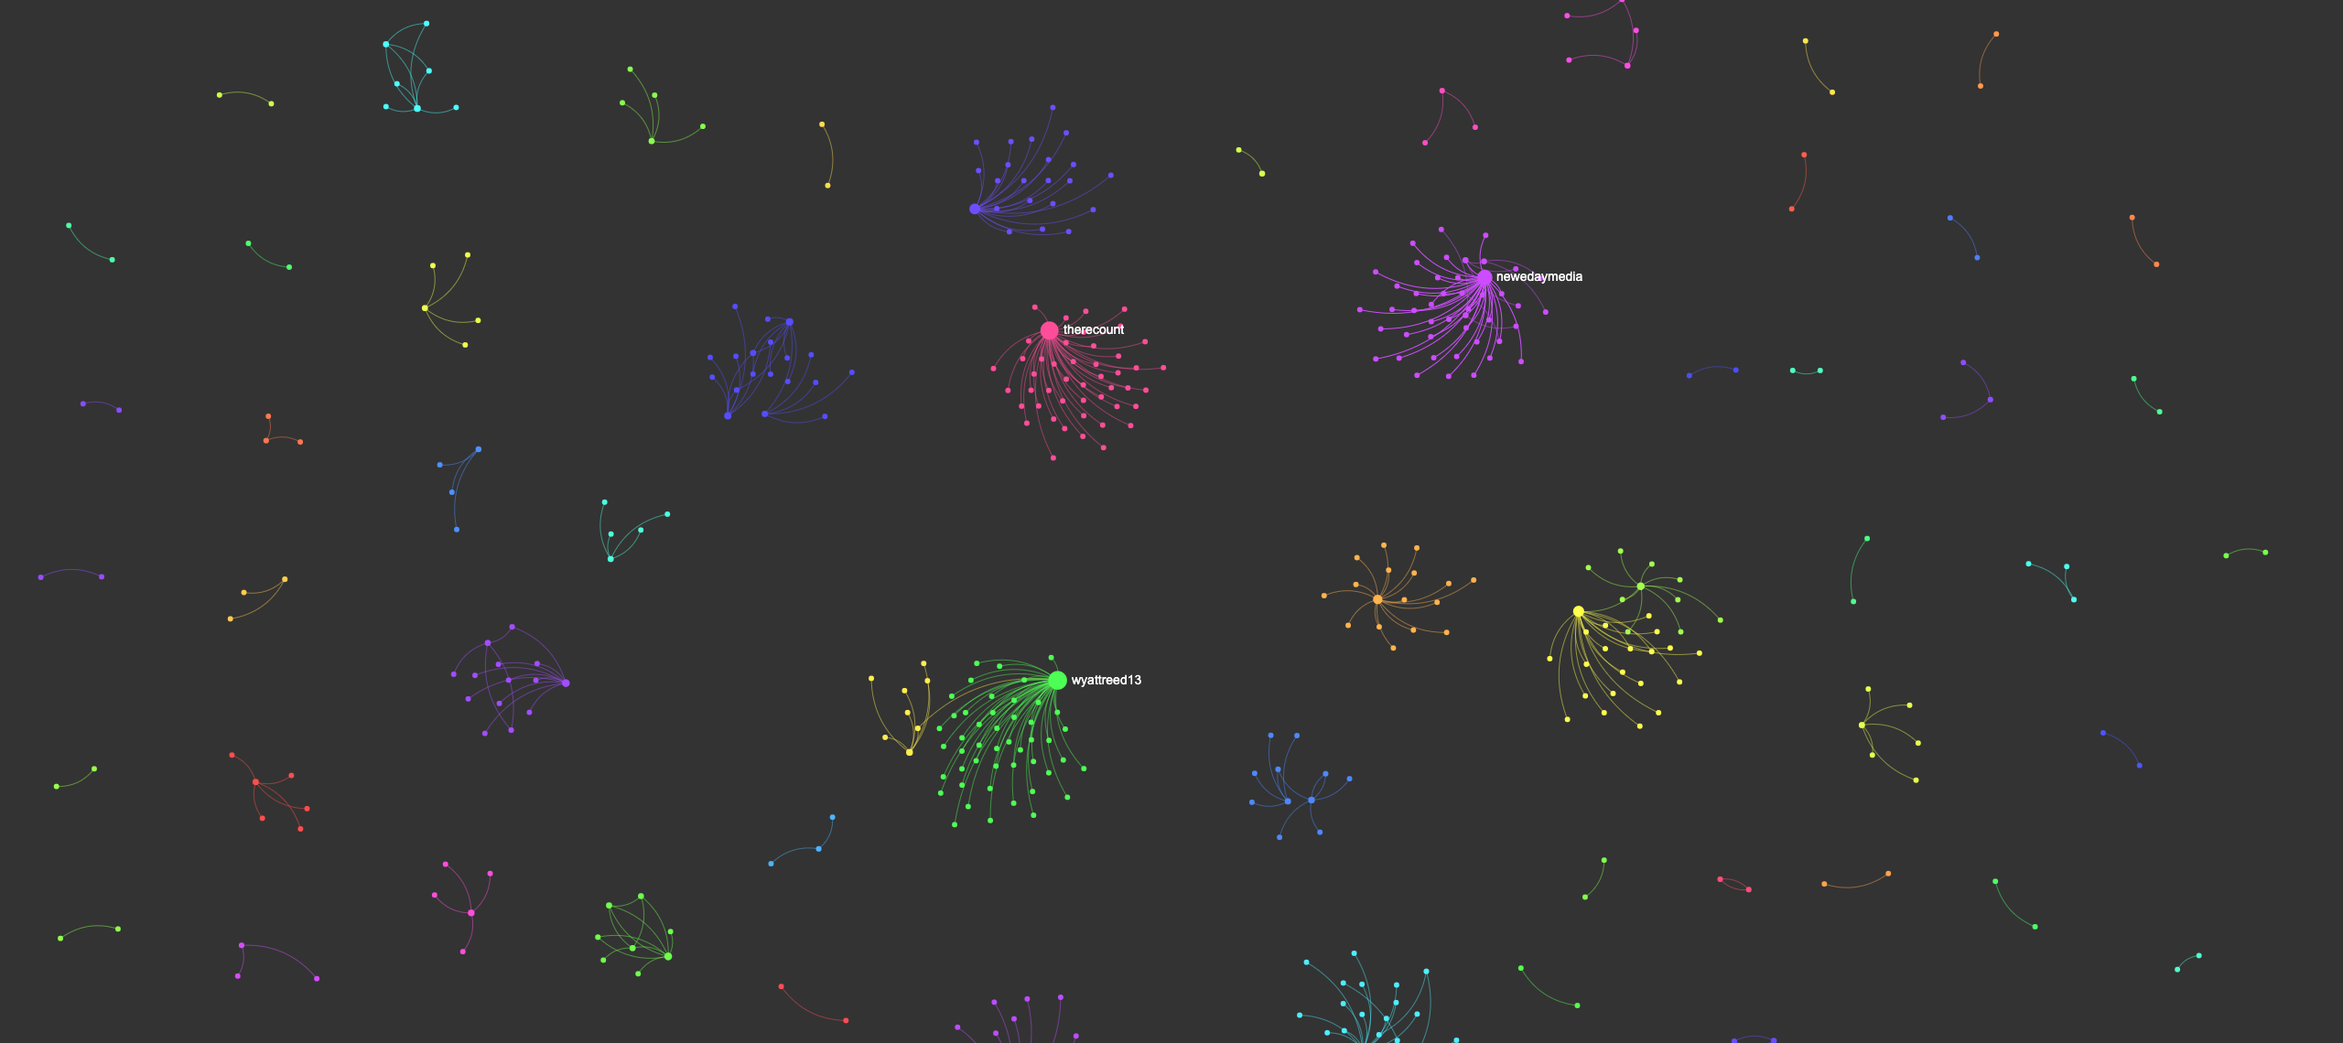
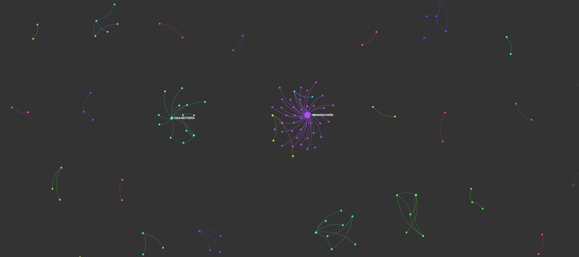
Network with retweets visualized
Network without retweets visualized

Slide 3
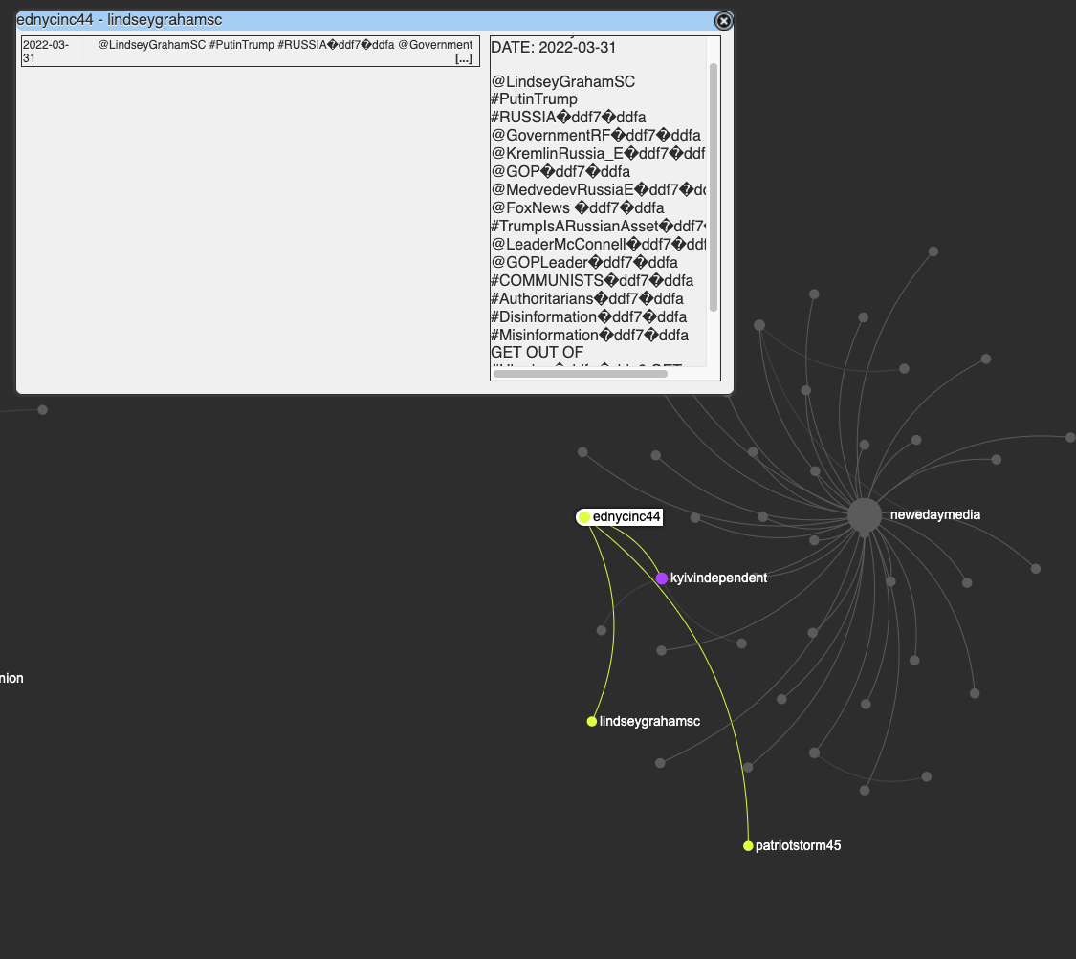
Bot behavior within a human network

